Slide 1

Y
OFFICE SUPPLY PERFOMANCE REPORT
FOR TEAM TEN ENTERPRISE
JANUARY 2013 – DECEMBER 2014
PRESENTED BY:
NWANDENDE CHINEMEREM CONFIDENCE & YAQUB AJIBOLA ONAFOWORA
(Team 10)

Slide 2

Table of Contents
01
Business Overview
01
Product Performance
02
02
03
Sales Performance by Product in 2014
03
04
Quarter 4 Overview
05
Performance by Tax
05
Conclusions and Recommendation
06

Slide 3



Business Overview
This Report aims to review the company’s Financial performance from January 2013 to December 2014. Data was analyzed to obtain revenue obtain.
The Analysis of this report was achieved using PowerBi and Power Point analysis tool.
Various computations were made to arrive at key business metrics to drive decision making.
Key metrics presented in this report include product performance, sales performance by product in 2014, Quarter 4 overview and performance by tax

Slide 4
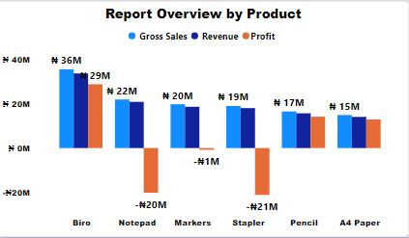
Product Performance
There are six (6) products – Biro, Notepad, Markers, Stapler, Pencil, A4 paper.
The top product by performance is Biro with highest profit followed by pencil and A4 paper, Biro having #29m profit.
The poor performing product are Notepad, Stapler, Marker, all having negative profit(Loss).

Slide 5
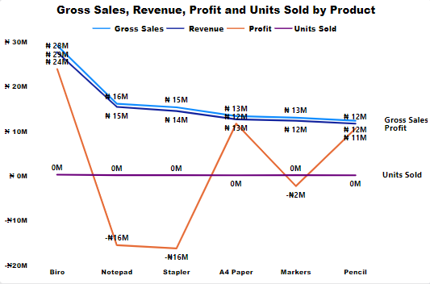
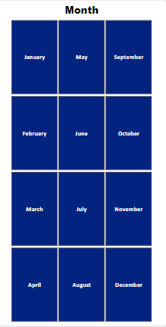
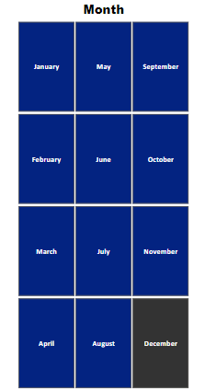
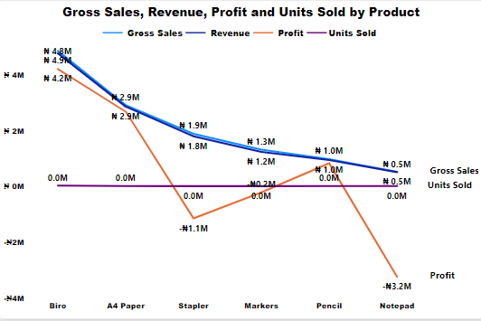
Sales Performance by Product ln 2014
By December 2014, A4 paper overtook pencil at the second position which led to an increase of the sales and profit. Biro is the product with more sales and profit.
Biro has 22% increase compare to what it had as at January in respect to sales and 27% increase on profit as well by the end of the year.
Biro has the highest performance (profit) across the year 2014.
Total of 861132 unit was sold in 2014 and biro had the highest unit sold.
Biro and pencil top the chart with the highest profit and sales by January 2014, Biro had #3.97M and #3.31M for sale Respectively.
Product like stapler and notepad had the least sales and also made loss at the end of January 2014.

Slide 6
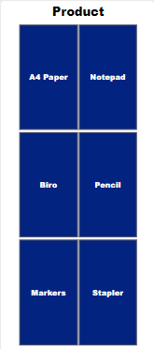
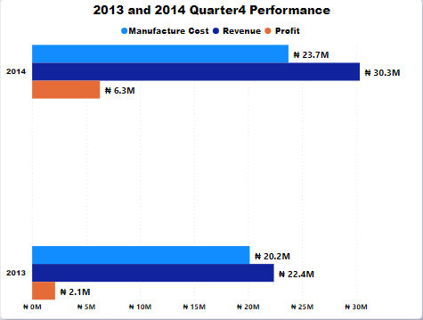
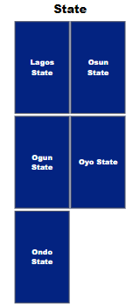
Quarter 4 0verview
Quarter 4 consist of 3 month that end the year – October, November, and December.
Performance in Q4 of 2014 is higher than that 2013 with 95% increase in profit, 17% increase in manufacturing cost and 35% by revenue.
Biro and A4 paper has the highest revenue and profit at Q4 in 2014 while it was biro and pencil that had the highest as at Q4 2014, There has being a deadline in the performance of pencil.
Ogun state and Osun state contributed the highest revenue and profit with Ogun state and it’s the highest followed by Osun state in Q4 2014. Also there was an increase in the manufacturing cost, revenue, and profit in Q4 2014 compare to Q4 2013.

Slide 7
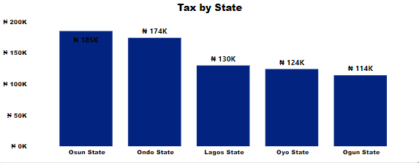
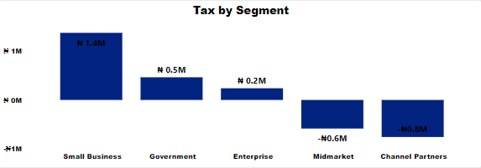
Performance by Tax
The highest tax was paid on biro being the product with the highest profit before tax, pencil is the second and A4 paper while both notepad and stapler had negatively tax.
At the state level, Osun state has the highest tax paid, followed by Ondo state. Also biro is the product with the highest tax contribution in each of the five state.
Small business leads followed by Government then Enterprise as the overall tax paid at segment category. Biro top the chart with the highest tax in each of the five segment as well.

Slide 8

Conclusion
The company has a strong financial performance over the two years (2013 -2014) under review. A total profit of # 13.8 million naira was achieved within the period under review.
Biro was the top product out of the six(6) products in terms of Gross sales and Profit etc.
Osun state and Ondo state has the highest profit with #3.31M respectively. Small business performed best among the segment.
However, they are areas of concern regarding some products like stapler, notepad and marker, but with proper review internally from the organization and further marketing strategy and innovative approaches, we believe that organization can fund the current products that are performing badly, which will help translate to future profit.

Slide 9



Recommendation
The company revenue had a major increase towards the end of the year(s) with a sharp rise in the last quarter. The activities of the business at this period can be replicated all year long with a view of further growth. Also we made more profit in the Q4 of 2014 compared to 2013 Q4
There should be more direct investment into the production of biro, which is the ‘Driver of performance’ of the company in comparison with the other products. Biro has the highest profit valued at #28.86, pencil A4 paper can also be considered in equal measure for more investment as they came second and third in respect to the profit made.
The product Stapler, Markers and Notepad should be greatly reviewed and examined as they made significant amount of losses over the period in review.

Slide 10

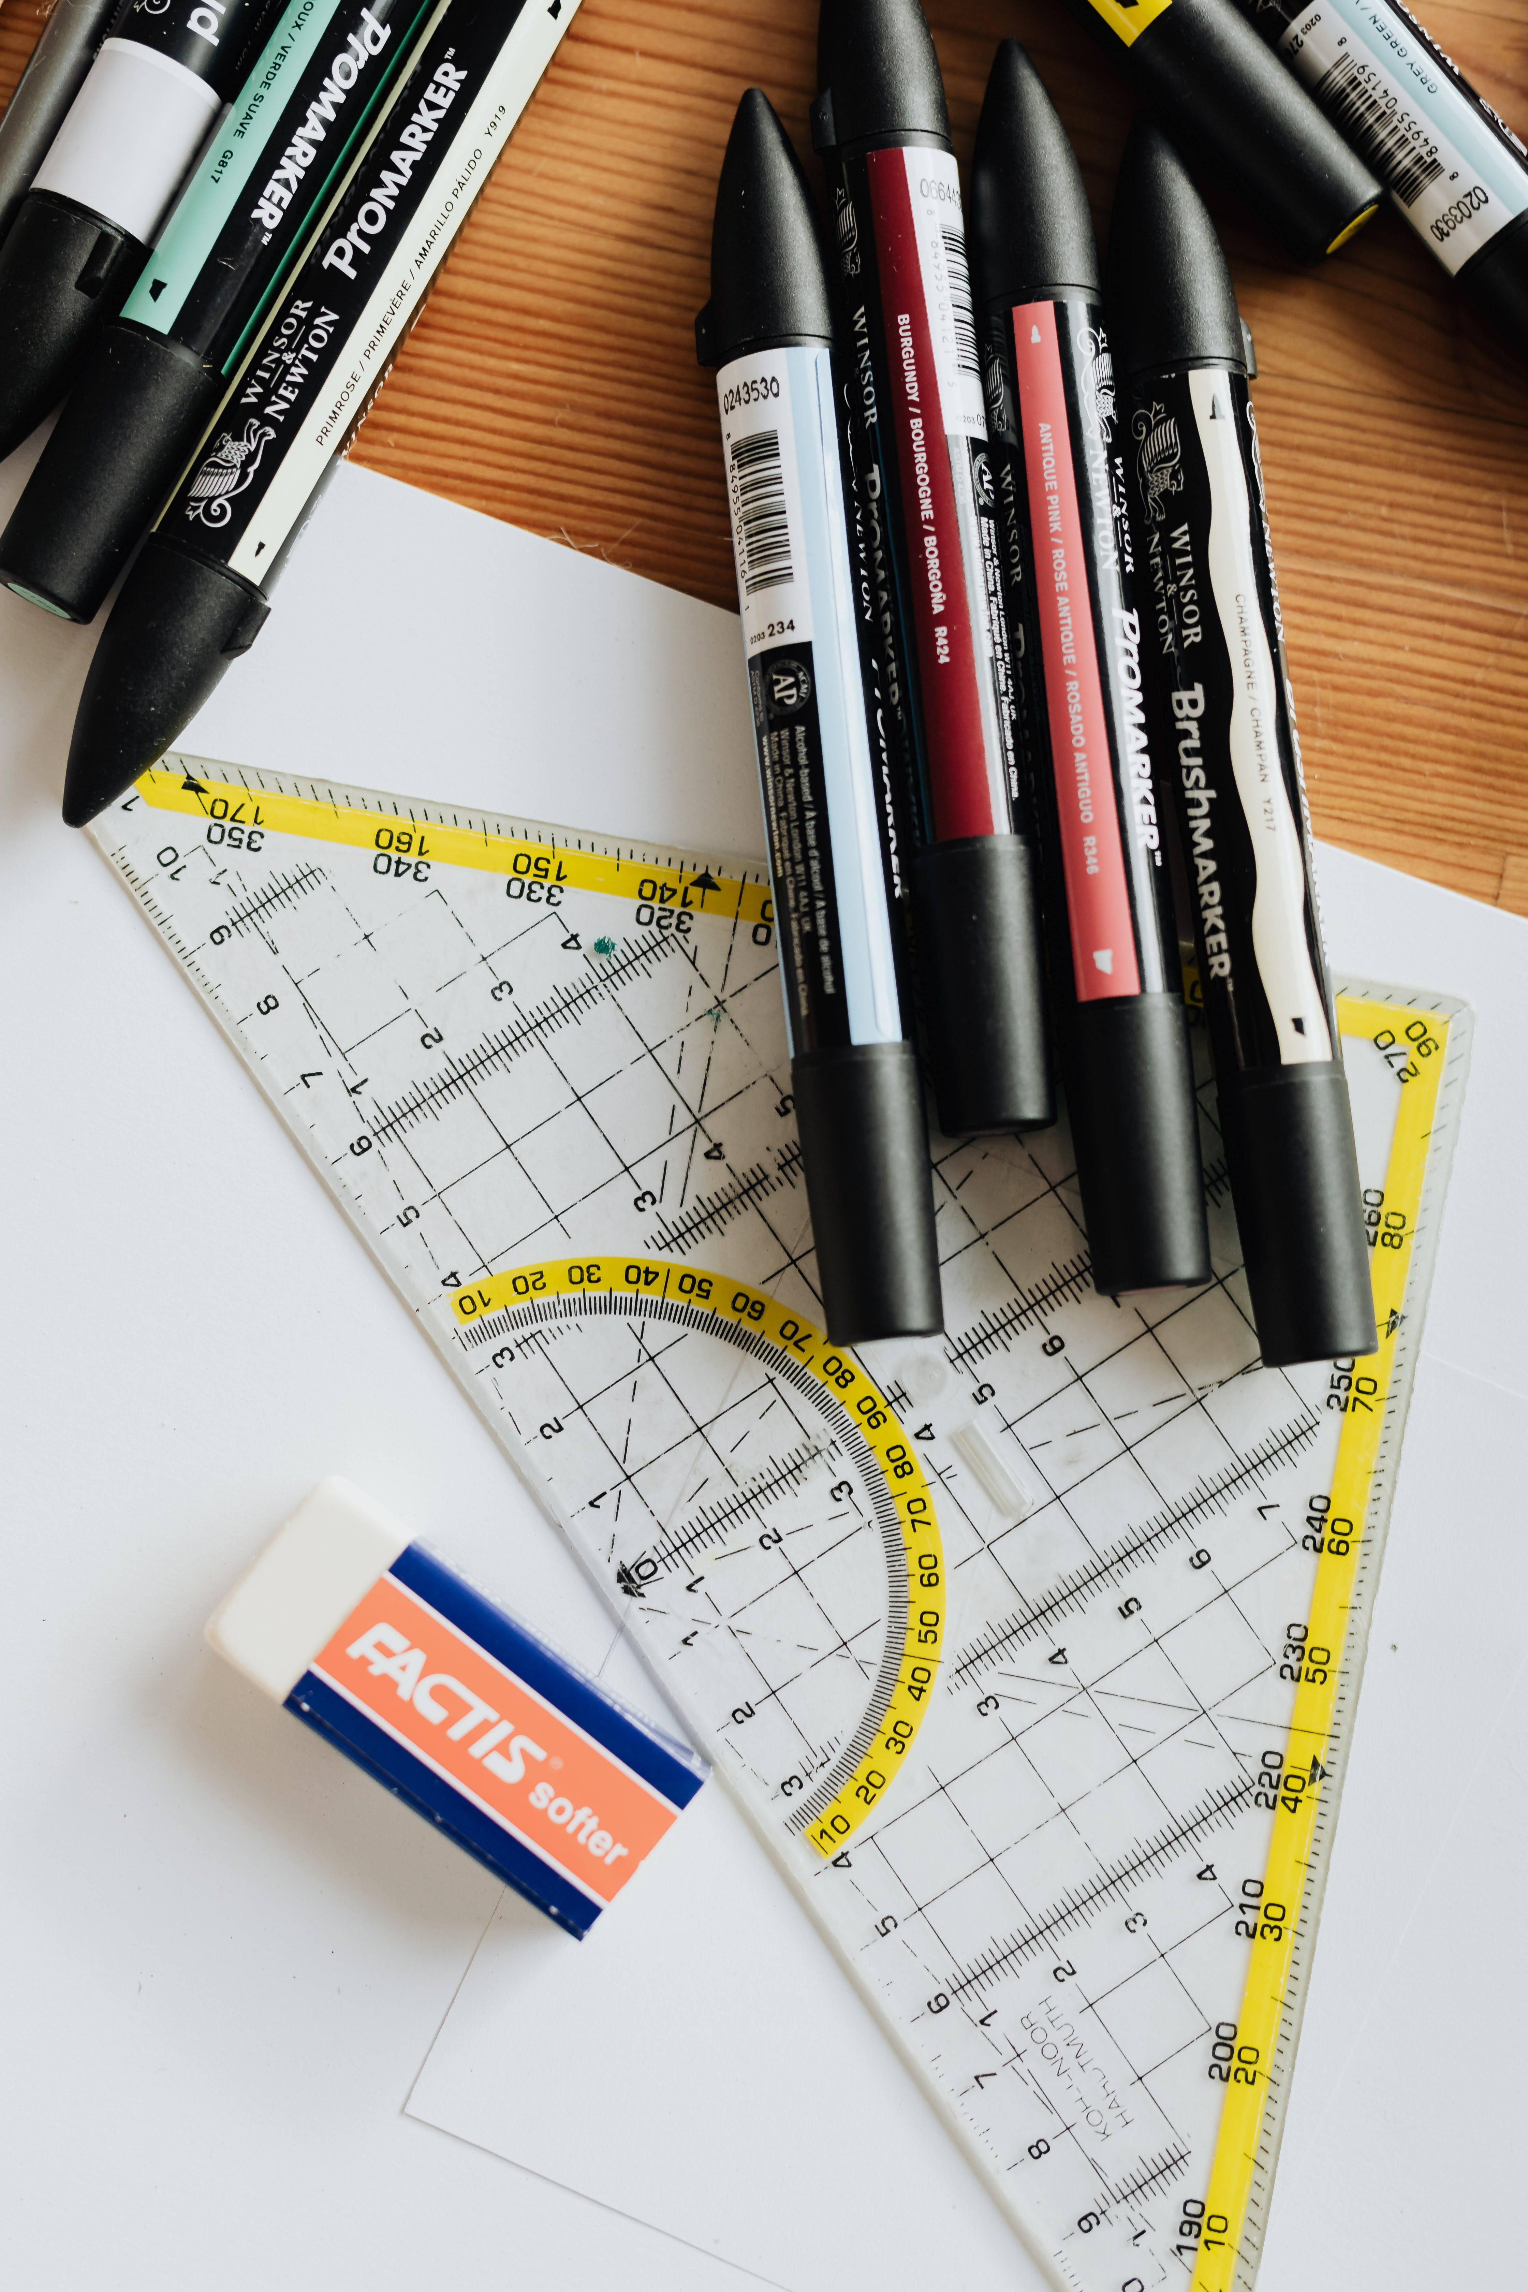
THANK YOU

